Slide 1

STRESS MANAGEMENT

Slide 2

STRESS MANAGEMENT
Stress management refers to the techniques and strategies used to reduce, control, and cope with stress effectively. It involves adopting practices that enhance emotional, mental, and physical well-being, helping individuals maintain balance and productivity even in challenging situations
Reduce Stress
Control Reactions
Techniques to lower stress levels in daily life
Methods to manage responses to stressful situations
Cope Effectively
Strategies to maintain well-being during challenging times

Slide 3


TWO TYPES
1.INDIVIDUAL STRATEGIES
2.ORGANISATIONAL STRATEGIES
Individual Strategies
Organisational Strategies
Personal techniques that help individuals manage their own stress levels through healthy habits and mindfulness practices
Structured approaches implemented by companies to create a less stressful work environment and support employee wellbeing

Slide 4
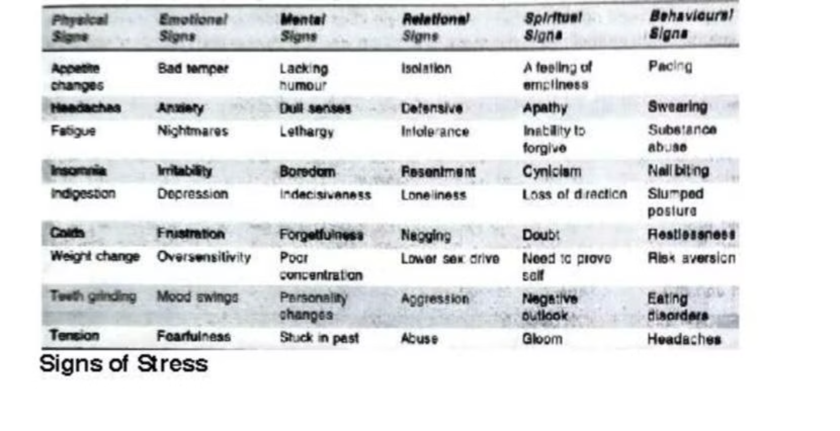
SIGNS OF STRESS

Slide 5



INDIVIDUAL STRATEGIES
These strategies help employees manage stress on their own by adopting healthy habits and techniques. Some effective coping strategies include:
Muscle Relaxation
Biofeedback
Tension builds up in the body due to stress, and muscle relaxation techniques help release it.
A technique that uses electronic monitoring to help individuals control bodily functions like heart rate and muscle tension.
Example: A person feeling physically stiff due to prolonged work hours can try progressive muscle relaxation, where they tense and then relax each muscle group from head to toe.
Example: A stressed individual might use wearable biofeedback devices to track stress indicators and practice relaxation techniques accordingly.

Slide 6




INDIVIDUAL STRATEGIES
Meditation
A mindfulness practice that enhances focus and emotional stability.
Example: An employee overwhelmed with deadlines can set aside 10 minutes daily for guided meditation to clear their mind.
Cognitive Restructuring
Changing negative thought patterns to reduce stress.
Example: Instead of thinking, "I can't handle this workload," an employee can reframe their thoughts to "I will prioritize my tasks and manage them step by step."
Time Management
Organizing tasks effectively to prevent stress caused by missed deadlines or overcommitment.
Example: A student juggling multiple assignments can use the Pomodoro Technique (25 minutes work, 5 minutes break) to maintain focus without exhaustion.

Slide 7




INDIVIDUAL STRATEGIES
Physical Fitness
Exercise helps regulate stress hormones and boosts overall well-being.
Example: A professional experiencing mental fatigue might incorporate morning jogs or gym workouts into their routine to enhance energy levels.
Sound Sleep
Restful sleep is essential for emotional regulation and cognitive function.
Example: Someone struggling with sleep can establish a bedtime routine, such as avoiding screens before bed and practicing relaxation techniques
Laughter/Yoga
Laughter and yoga enhance mood, reduce stress hormones, and promote relaxation.
Example: A workplace can introduce laughter therapy sessions or yoga breaks to boost employees' well-being

Slide 8
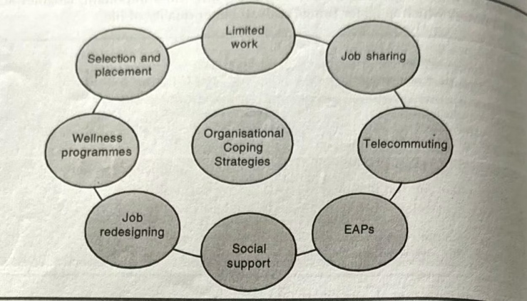




Organisational Strategies
Organisational strategies are structured efforts taken by a company or employer to reduce stress at the workplace. These strategies focus on changing the work environment, culture, policies, and processes to make them more supportive, flexible, and less stressful for employees. Here's a breakdown of the main de-stressing strategies you've listed
Work Environment
Culture
Physical workspace design and atmosphere
Company values and interpersonal dynamics
Processes
Policies
Work procedures and operational methods
Official rules and guidelines

Slide 9



Organisational Strategies
Redesigning Jobs
Modifying job roles to reduce stress by making work more meaningful and manageable.
Example: Toyota (Japan)
Toyota applies job rotation and Kaizen (continuous improvement) to reduce monotony and improve skill variety.
Employees take turns doing different tasks, keeping their minds engaged and reducing burnout.
Social Support
Encouraging a supportive work culture through peers and management.
Example: Google (USA)
Google has open communication culture, peer groups, and employee resource communities.
Managers are trained to support mental health and promote psychological safety, where employees feel safe sharing problems.
Job Sharing
Two employees share responsibilities of one full-time position.
Example: NHS (UK - National Health Service)
To accommodate nurses with family commitments, NHS introduced job sharing in critical care departments.
It helps retain skilled staff and reduce burnout, especially in high-stress environments.

Slide 10
Organisational Strategies
Employee Selection and Training
Limited Work Hours
Hiring the right people and training them to handle stress better.
Telecommuting (Work from Home)
Capping overtime and encouraging work-life balance.
Allowing employees to work from home full-time or part-time.
Example: Southwest Airlines (USA)
Example: Volkswagen (Germany)
Focuses heavily on attitude during hiring—"hire for attitude, train for skill."
Example: Dell Technologies (USA)
Volkswagen stopped after-hours email servers to reduce work intrusion into personal time.
Dell has a flexible telecommuting policy allowing employees to work remotely.
They train staff on customer interaction and stress handling, resulting in happier teams and loyal customers.
This policy helped employees disconnect and mentally recover after work.
Reported higher employee satisfaction and lower attrition, with 80% of staff working remotely at least once a week.

Slide 11








Benefits of Effective Stress Management
Improved Performance
Enhanced productivity and quality of work
Better Health
Reduced physical and mental health issues
Higher Satisfaction
Increased job and life satisfaction
Work-Life Balance
Healthier boundaries between professional and personal life
When both individual and organizational strategies are implemented effectively, the result is a healthier, more productive workplace with lower turnover rates and higher employee engagement.

